Slide 1

Russian Federation: A discriminant analysis on the paleoclimatology in Russia
Julia Cuellar
DSC 680

Slide 2

Abstract
Figure 1 Russian Flag
The Russian Federation is a Eurasian country that is rich in history as well as paleoclimatology. Russia also has two significant lakes (Lake Baikal and Lake Elgygytgyn) with collected biogenic silica and sediments during the Pleistocene epoch or Quaternary period. A discriminant analysis will be performed on three different collections of data based off of the paleoclimatology in Russia.

Slide 3
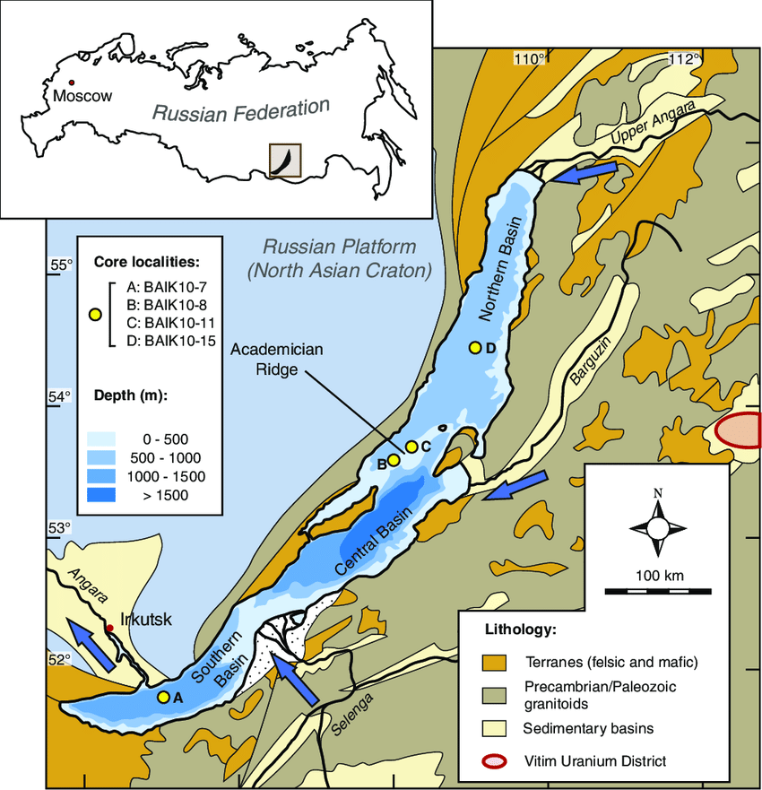
Background
Figure 2 Lake Baikal
Lake Baikal is a rift lake located in Russia, situated in southern Siberia. It is the deepest, oldest, and largest freshwater lake by volume in the world. While Lake Elgygytgyn is an impact crater lake located in northeast Siberia. Compared to Lake Baikal, Lake Elgygytgyn’s purpose is for a multinational drilling campaign.

Slide 4
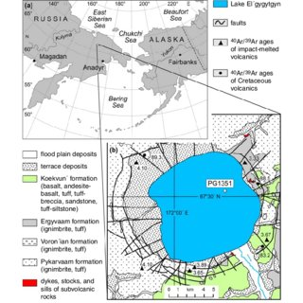
Business Understanding
Figure 3 Lake Elgygytgyn
Both Lake Baikal and Lake Elgygytgyn have a unique establishment of when these bodies of water were formed in the country of Russia. Since both Russian lakes were formed ages ago, biogenic silica as well as sediments are buried under layers of deposits within both lakes. Hence, a discriminant analysis based off a common column variable from three different file formatted data of the two Russian lakes will be performed to understand how separate data can be collaborated into a single dataset which in then transfers into a database.

Slide 5
Data Understanding – Baikal
A dataframe with 3,669 observations and 7 variables.
(Head)
Hole Core-Sec Int Depth Biosil Age X
1: BDP-96-2 GC-1 11 0.11 13.1 11.4 876.7123
2: BDP-96-2 GC-1 13 0.13 15.7 11.9 876.7123
3: BDP-96-2 GC-1 15 0.15 13.5 12.3 876.7123
4: BDP-96-2 GC-1 17 0.17 7.7 12.8 876.7123
5: BDP-96-2 GC-1 21 0.21 8.8 13.7 876.7123
6: BDP-96-2 GC-1 23 0.23 4.5 14.2 876.7123

Slide 6
Data Understanding – Lake
A dataframe with 91 observations and 9 variables.
(Head)
Age MTWM-degC MTWM-deg-C MTWM-deg+C PANN-mm PANN--mm PANN-+mm Trees & Shrubs Picea
1 0.000000 8.800000 8.800000 8.800000 255.0000 255.0000 255.0000 63.0 0
2 2.596983 8.888037 8.792730 8.992730 253.3380 253.3380 253.3380 74.9 0
3 2.929250 9.151988 9.072456 9.272456 259.9207 259.9207 259.9207 67.2 0
4 3.479885 8.898796 8.850015 9.050015 258.6479 258.6479 258.6479 61.6 0
5 4.090889 8.927818 8.850605 9.050605 258.6614 258.6614 258.6614 71.1 0
6 4.461754 8.896577 8.800574 9.000574 253.3380 253.3380 253.3380 73.8 0

Slide 7
Data Understanding – Lake2
A dataframe with 99 observations and 19 variables.
(Head)
Age Picea.sect..Eupicea P..s.g.Haplo.T Larix Betula Alnus Salix Poaceae Cyperaceae Artemisia Ericales Cphae Papae
1 1.50 0 8.1 0 33.2 36.8 0.8 9.2 4.9 3.2 0.8 0.8 0.8
2 2.27 0 7.2 0 25.2 37.2 0.6 12.9 7.2 2.1 3.0 0.0 0.3
3 2.62 0 16.1 0 12.4 38.7 0.6 13.3 2.3 5.6 1.1 2.8 2.0
4 3.14 0 12.6 0 21.0 38.9 1.0 10.1 8.9 2.7 1.7 0.0 0.5
5 3.46 0 7.7 0 24.6 43.8 0.8 7.9 5.8 4.2 1.5 0.2 1.0
6 3.65 0 11.5 0 12.4 35.1 0.3 24.2 3.4 3.1 0.3 0.9 2.5
Ranae Tha Sax Lyc.a.T Sel.r Sph
1 0.3 0.0 0.0 0.3 1.9 2.7
2 0.3 0.0 0.0 0.0 2.4 1.8
3 0.0 0.3 0.3 0.8 4.5 2.8
4 0.2 0.0 0.7 0.0 1.7 1.5
5 0.2 0.0 0.0 0.2 0.8 1.7
6 0.0 0.3 0.0 1.5 6.2 8.7

Slide 8
Data Preparation
Due to the fact that these datasets are supplied from data.gov, there is no Nulls, but there is NA’s, thus the only data manipulation will be replacing those NA’s as well as renaming column variables.

Slide 9
Business Question
What is the common column variable that can be made from these 3 different file formats (txt, JSON, & xls) to merge into a database?

Slide 10
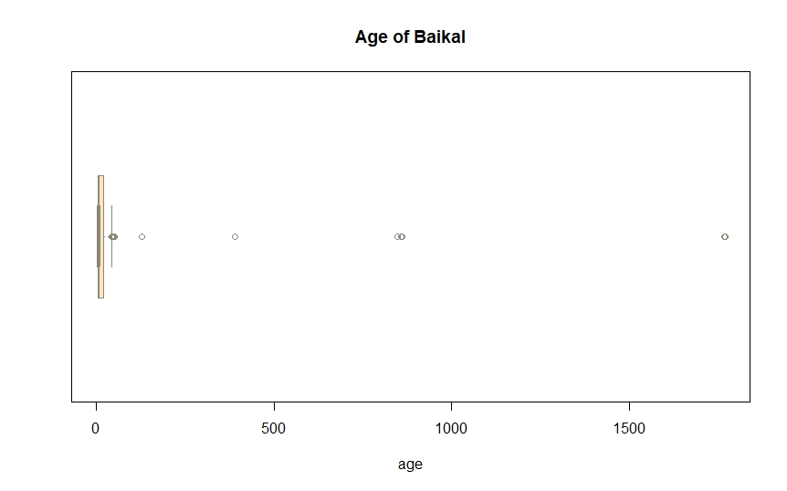
Age of Baikal
Boxplot for Age of Baikal
A boxplot was made for the age variable based off the Baikal data set; there is outliers which will still be included (i.e., not removed from the original dataset).

Slide 11
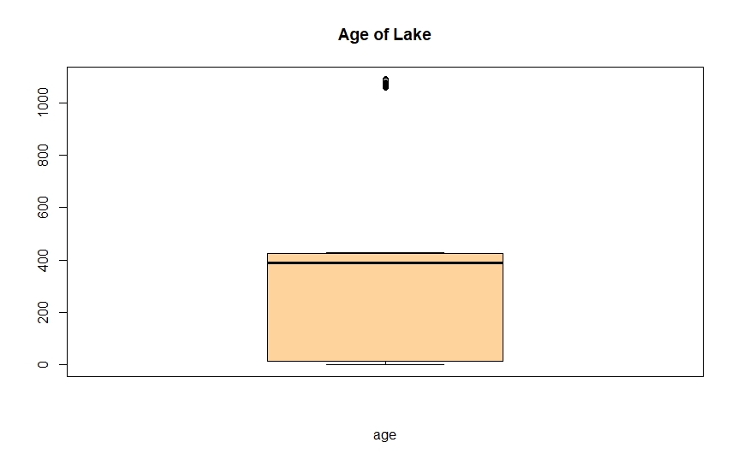
Age of Lake
Boxplot for Age of Lake
A boxplot was made for the age variable based off the Lake data set; there is outliers which will still be included (i.e., not removed from the original dataset).

Slide 12
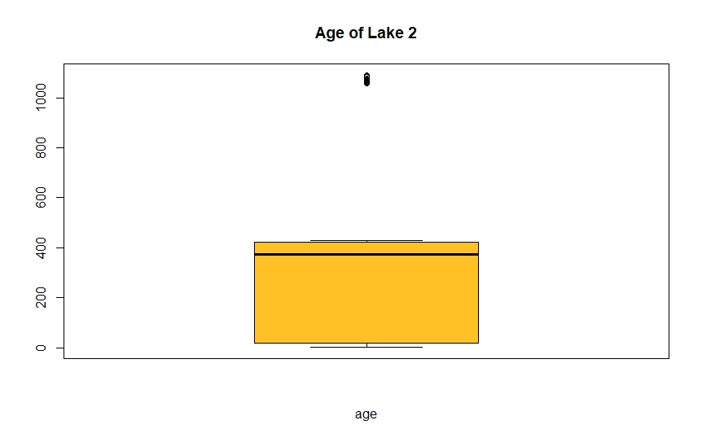
Age of Lake2
Boxplot for Age of Lake2
A boxplot was made for the age variable based off the Lake2 data set; there is outliers which will still be included (i.e., not removed from the original dataset).

Slide 13
Assumption
The common column variable will be the Age variable due to varying differences between Lake Baikal and Lake Elgygytgyn in the Russian Federation based off the paleoclimatology in that Eurasian country.
Upon performing exploratory data analysis (or EDA) with boxplots as well as removing the NA’s and renaming the column variables when considering the business question, the Age variable will be the common column variable name.

Slide 14
Modeling/Methods
To perform this discriminant analysis based off the common column variable, Age, rudimentary EDA will be executed followed by converging the datasets into a single dataset and implementing them into a database.

Slide 15
Deployment/Results
After finding a common column variable (i.e. Age) between the different file formatted datasets and placing the conjoined dataset into a database, a performance check should be implemented but has no relevance in this particular discriminant analysis.
Dimension: 3,856 rows & 33 columns

Slide 16
Summary & Conclusions
Since the three different datasets were structurally formatted in a way where there is some data preparation or wrangling that needs to be done, the more legwork will be finding the common column variable and inputting the merged data into a database based off the business question proposed to the business problem of which column variable is the link between the three datasets to form a single dataset and tool it into a database. Following the CRISP-DM process, after discovering the common column variable, a performance check should be administered but this has no significance to this discriminant analysis.

Slide 17
Summary & Conclusions cont.
For the business problem, the Age column variable was the common variable from each dataset. This was due to the fact of the varying in age for the biogenic silica and sediments collected at both Lake Baikal and Lake Elgygytgyn.

Slide 18
Summary & Conclusions cont.
Lastly, an understanding of what the discriminant analysis of the datasets will be executed. This discriminant analysis concluded with the three different file formatted data (txt, JSON, & xls) being merged into a single dataset by the Age variable (the common column variable name) and placed within a database (SQLite). The merged data had a dimension of 3856 rows & 33 columns, a little more from the original datasets, but this database data was joined together by the Age column variable. What was significant about the Age column in the database data from a simple boxplot indicates that the age of the sediments collected at Lake Elgygytgyn is older compared to the age of biogenic silica buried at Lake Baikal even though this lake is way older compared to the newer lake, Lake Elgygytgyn. In conclusion, to study the paleoclimatology of the biogenic silica in Lake Baikal and the sediments in Lake Elgygytgyn, the age of both minerals should be considered within the two lakes, thus showing the significance of the Age column variable during the Pleistocene epoch/Quaternary period.

Slide 19
References
10 Key Types of Data Analysis Methods and Techniques. (n.d.). Retrieved from 10 Top Types of Data Analysis Methods and Techniques (intellspot.com)
Lake Baikal. (n.d.). Retrieved from Lake Baikal - Wikipedia
Lake Baikal: The Pearl of Siberia. (n.d.). Retrieved from Lake Baikal in Siberia, Russia | Baikal Lake Facts & Map (lakepedia.com)
Lake Elgygytgyn. (n.d.). Retrieved from Lake Elgygytgyn - Wikipedia
NOAA/WDS Paleoclimatology – Lake Baikal Composite BDP-96 Pleistocene Biogenic Silica Data. (n.d.). Retrieved from NOAA/WDS Paleoclimatology - Lake Baikal Composite BDP-96 Pleistocene Biogenic Silica Data - CKAN
NOAA/WDS Paleoclimatology – Lake El’gygytgyn, NE Russia Quaternary Multiproxy Lake Sediment Data. (n.d.). Retrieved from NOAA/WDS Paleoclimatology - Lake El'gygytgyn, NE Russia Quaternary Multiproxy Lake Sediment Data - CKAN
Pleistocene Epoch. (n.d.). Retrieved from Pleistocene Epoch | Characteristics, Plants, Animals, Climate, & Facts | Britannica
Strauss, B. (2020, January 21). Prehistoric Life During the Pleistocene Epoch. Prehistoric Life During the Pleistocene Epoch (thoughtco.com)
The Thrill to Drill in the Chill – 3.6 Million Years of Arctic Climate Change from Lake El’gygytgyn, NE Russia. (n.d.). Retrieved from | Lake El’gygytgyn (dosecc.com)
Vermillion, S. (2021, April 16). Siberia’s Lake Baikal Is the World’s Oldest and Weirdest. Siberia's Lake Baikal Is the World's Oldest and Weirdest | HowStuffWorks
What is Paleoclimatology?. (n.d.). Retrieved from What is Paleoclimatology? | National Centers for Environmental Information (NCEI) formerly known as National Climatic Data Center (NCDC) (noaa.gov)

Slide 20
Appendices
Appendix A
What is Paleoclimatology?
The article defines what paleoclimatology is as well as the benefits of the scientific study.
Appendix B
Pleistocene Epoch
This article defines when the Pleistocene epoch occurred, the stratigraphy, and lastly, the chronology and correlation of the epoch.

